Slide 1
Canteen
Smt. Chandaben Mohanbhai Patel Homoeopathic Medical College

Slide 2
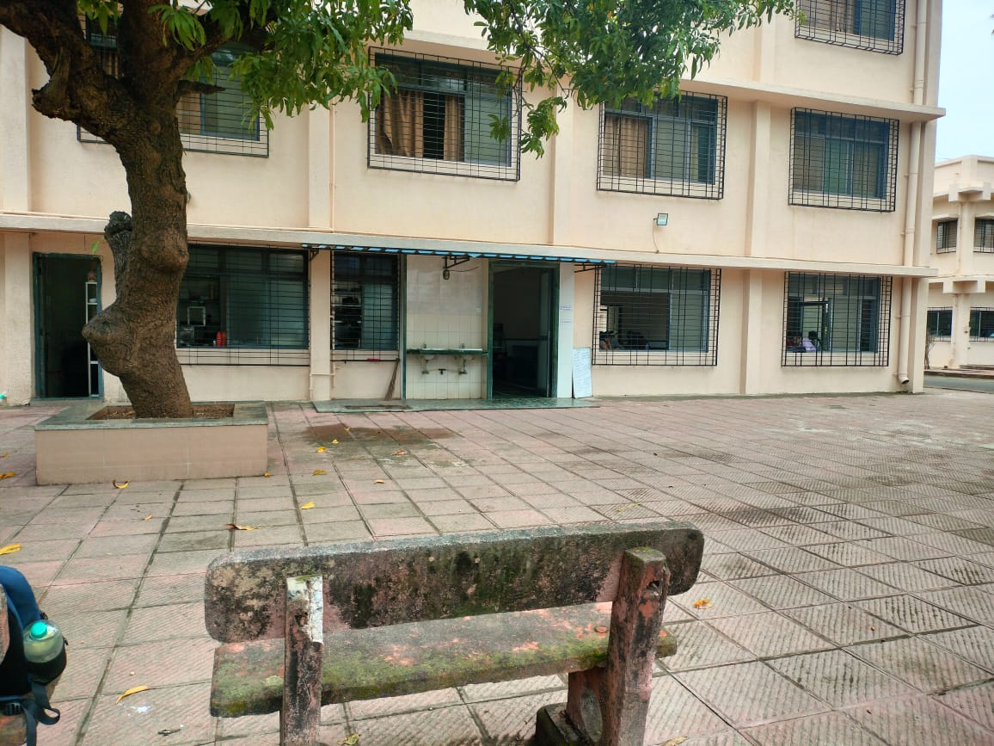

Slide 3
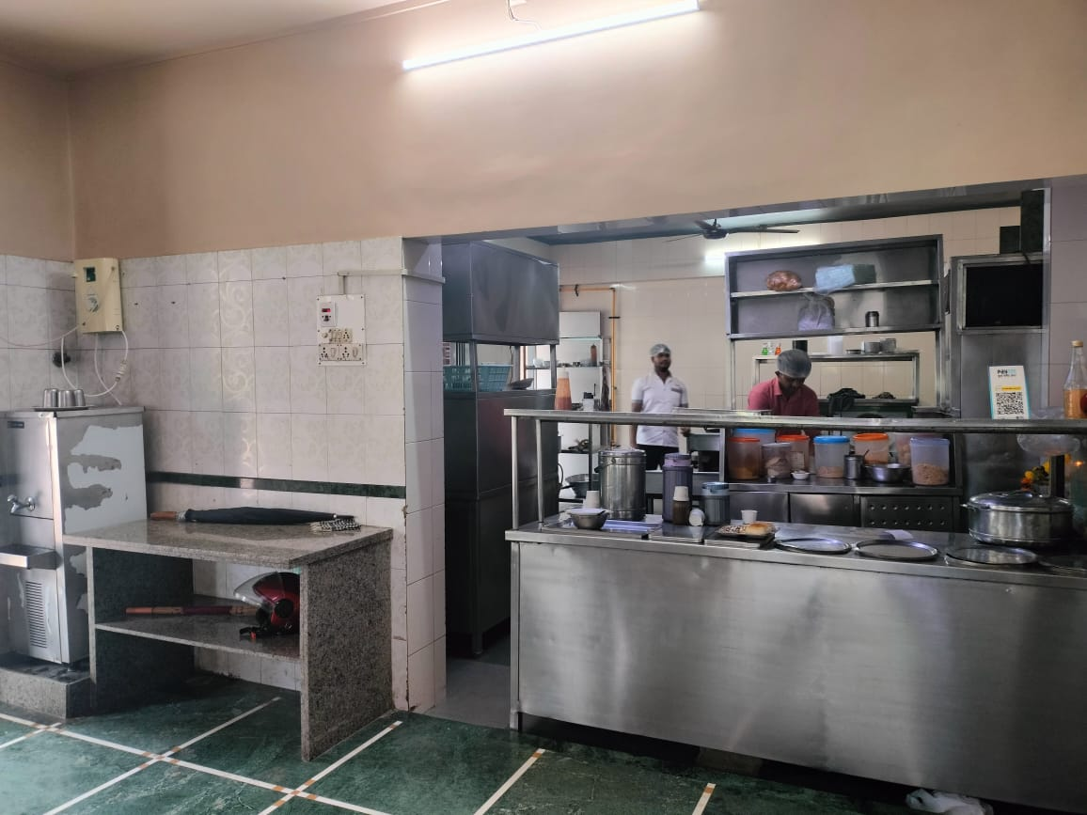

Slide 4
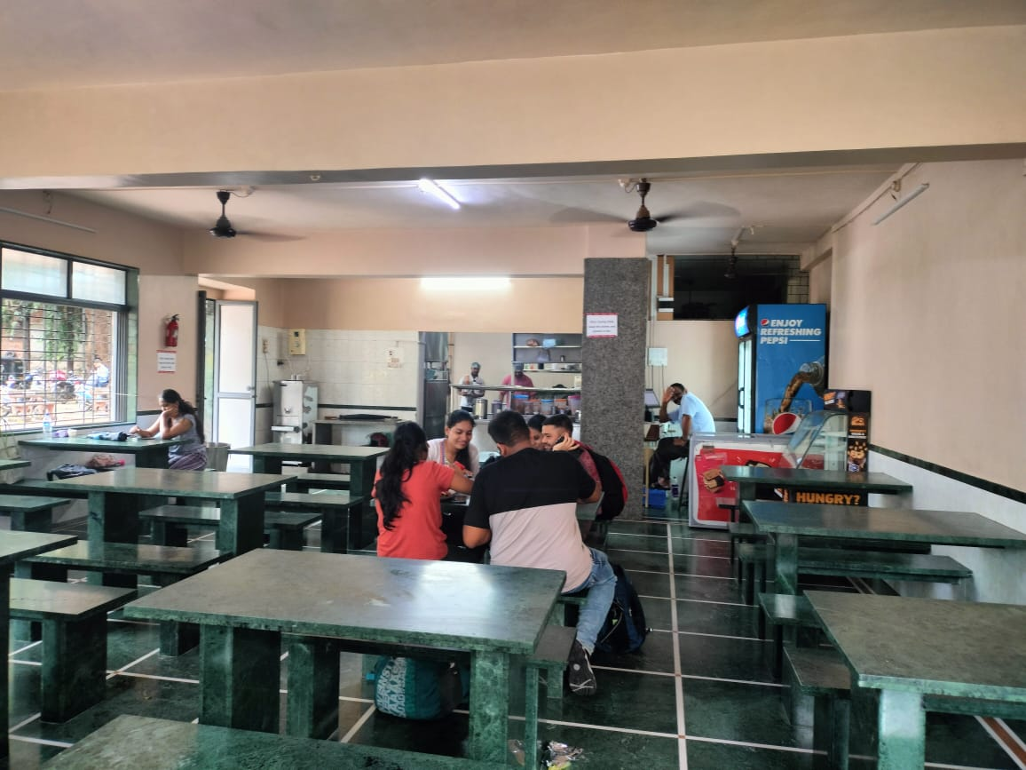

Slide 5
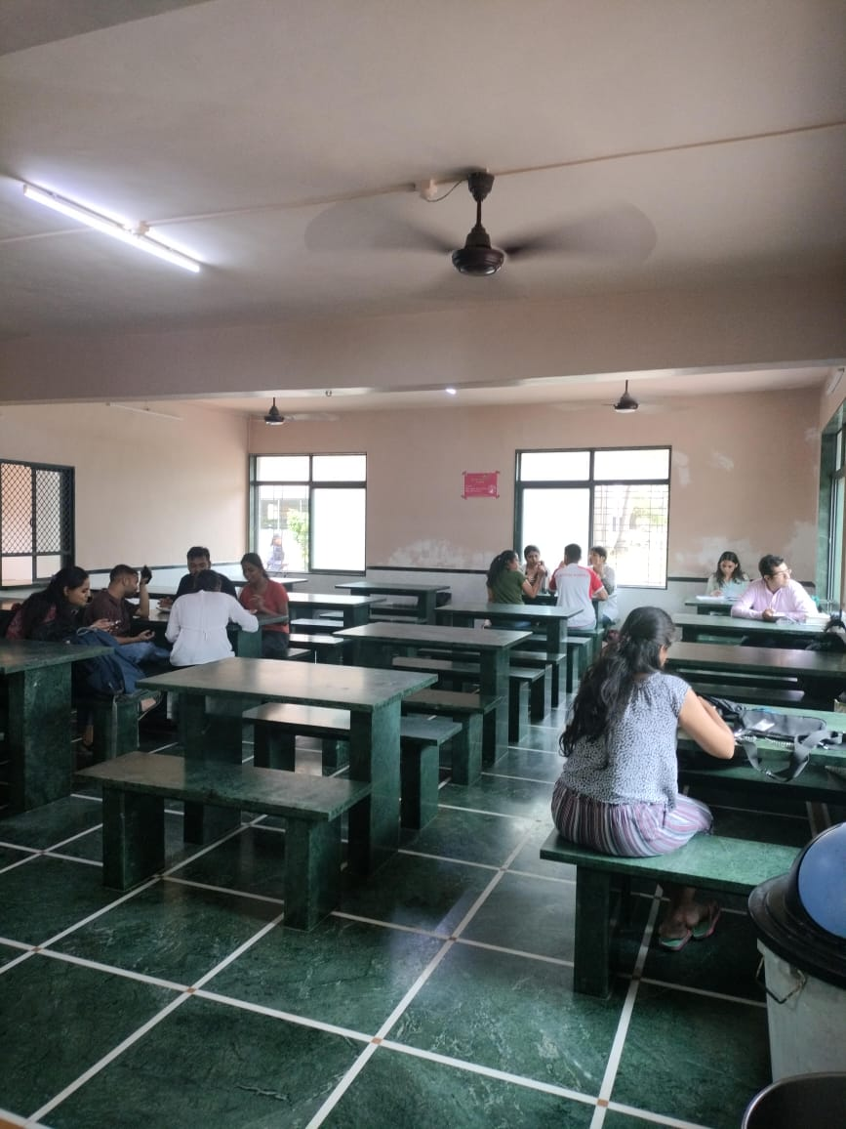

Slide 6
